Slide 1
The Global Sales Report Presentation

Slide 2
Unlocking Insights: A Deep Dive into Sales Data
Total Sales By Category
Total Sales Over Date
Sales by Region
Total Sales By Sub Category
Total Sales
Sales On Country
Return By Country
Top 10 Selling Product
Sales On Segment
Sales Performance Summary

Slide 3
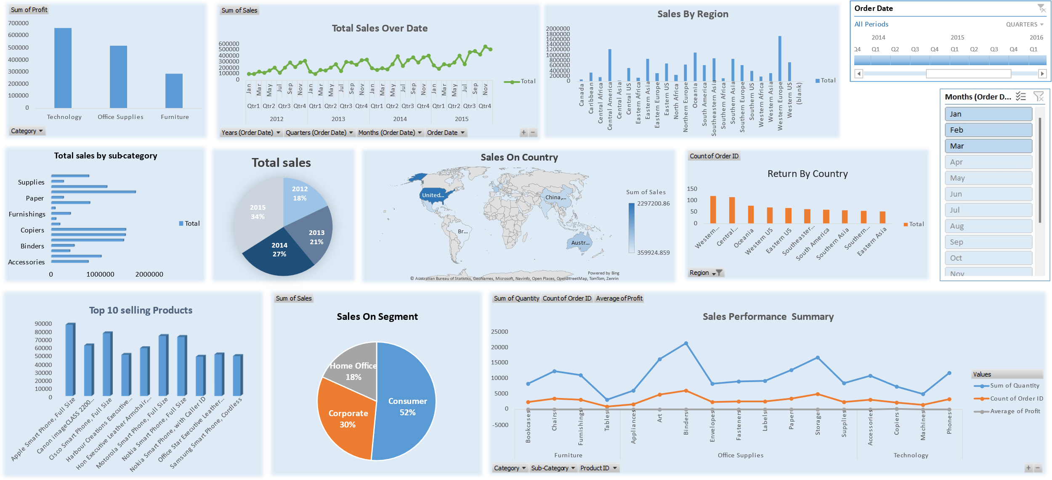
Sales Performance Insights: A Global Perspective

Slide 4
Sales Performance Insights: A Global Perspective

Slide 5
Total Sales By Category
Insights:
Technology Leads in Sales: The Technology category generates the highest total sales among the three categories, indicating a strong demand for tech products.
Office Supplies Hold Steady: The Office Supplies category maintains a respectable level of sales, suggesting consistent demand for essential office items.
Furniture Shows Potential: While Furniture has the lowest sales among the three categories, it still contributes significantly to overall revenue, indicating potential for growth with focused strategies.

Slide 6
Total Sales Over Date
Insights:
Overall Sales Growth: Total sales have steadily increased over the years, from 2012 to 2015, indicating a positive growth trajectory for the company.
Seasonality Pattern: There is a consistent seasonal pattern in sales, with peaks typically occurring in the fourth quarter (Q4) of each year, suggesting a strong holiday season sales effect.
Sales Fluctuations: Within each year, there are noticeable fluctuations in sales from quarter to quarter and month to month, indicating the potential influence of various factors like promotions, product launches, or market trends.

Slide 7
Sales by Region
Insights:
Western Europe Dominates Sales: Western Europe stands out as the region with the highest sales, significantly surpassing all other regions. This indicates a strong market presence and potential for further growth in this region.
North America Shows Potential: Both Canada and the US (Eastern and Central regions) demonstrate considerable sales figures, suggesting a substantial market share and potential for expansion within the North American market.
Uneven Distribution: There is a significant disparity in sales across different regions. Some regions, such as the Caribbean, Central Asia, and most African regions, have considerably lower sales, highlighting potential untapped markets or areas that may require different strategies

Slide 8
Total Sales By Sub Category
Insights:
Paper is the top-selling sub-category: The "Paper" sub-category has the highest total sales, significantly exceeding other categories. This suggests a high demand for paper products in the market.
Binders and copiers are also strong performers: The "Binders" and "Copiers" sub-categories follow closely behind in terms of total sales, indicating they are also popular product categories. This could be attributed to the essential role they play in offices and businesses.
Furnishings and accessories have lower sales: The "Furnishings" and "Accessories" sub-categories have the lowest total sales, suggesting a lower demand for these types of products compared to others. This information could be useful for inventory management or marketing strategies.

Slide 9
Total Sales
Insights:
Significant Sales Growth: Total sales have experienced significant growth from 2012 (18%) to 2015 (34%), indicating a positive trend for the company over this period.
Consistent Improvement: Sales increased consistently each year from 2012 to 2015, with the largest jump occurring between 2014 (27%) and 2015 (34%).
2015 as the Peak Year: 2015 stands out as the most successful year in terms of sales, accounting for nearly a third of the total sales during this period. This could be due to a variety of factors such as new product launches, successful marketing campaigns, or favorable market conditions.
Early Years Contribution: While smaller compared to later years, the sales in 2012 (18%) and 2013 (21%) still contribute significantly to the overall sales figures, forming a foundation for future growth
Potential for Future Growth: The consistent upward trend in sales suggests that the company has the potential for continued growth in the coming years, if the positive momentum can be maintained.

Slide 10

Sales On Country
Insights:
United States Dominance: The United States is the clear leader in sales, significantly outperforming other countries. This suggests a strong market presence and potential for continued growth within the US market.
China as a Significant Player: China holds a notable position in terms of sales, indicating a substantial market and potential for further expansion in this region.
Limited Geographic Diversity: Sales appear to be concentrated in a few key countries (US, China, Brazil, Australia), suggesting a potential opportunity for expansion into other markets to diversify revenue streams and reduce reliance on a few key areas.

Slide 11
Return By Country
Insights:
Western Europe Leads in Returns: Western Europe has the highest number of returns, significantly more than any other region. This could indicate issues with product quality, customer satisfaction, or logistics in that region.
Central America and Oceania Follow: Central America and Oceania are the next highest in terms of returns, although significantly less than Western Europe. This suggests that these regions might also warrant attention to address any potential problems.
Consistent Returns Across Other Regions: The remaining regions (Western US, Eastern US, Southeastern Asia, South America, Southern Asia, Eastern Asia) have relatively similar numbers of returns, indicating a more even distribution of return issues in these areas.

Slide 12
Top 10 Selling Product
Insights:
Apple Dominates: Apple Smart Phone (Full Size) is the clear top-seller, significantly outperforming all other products. This suggests strong brand loyalty and demand for Apple products.
Smartphones Lead the Way: The majority of the top 10 products are smartphones, indicating a high demand for this product category. This could be attributed to the increasing reliance on mobile technology in both personal and professional lives.
Canon Printer in the Mix: The Canon imageCLASS 2200 printer securing a spot among the top sellers suggests a consistent need for office equipment, even in a digital age.

Slide 13
Sales On Segment
Insights:
Consumer Segment Dominates: The consumer segment accounts for the majority (52%) of sales, indicating that individual customers are the primary drivers of revenue.
Corporate Segment Contributes Significantly: The corporate segment holds a substantial share (30%) of sales, suggesting that businesses are a valuable customer group for the company.
Home Office Segment Has Potential: While the home office segment has the smallest share (18%), it still represents a significant portion of the market, indicating an opportunity for growth and targeted marketing efforts towards this segment.

Slide 14
Sales Performance Summary
Insights:
Demand and Order Volume: The blue line ("Sum of Quantity") indicates that "Paper" has the highest demand, followed by "Phones" and "Binders". However, the orange line ("Count of Order ID") suggests that "Phones" are ordered more frequently than "Paper", despite having lower overall quantity sold. This implies that individual orders for "Phones" are smaller than those for "Paper".
Profitability Challenges: The gray line ("Average of Profit") reveals that most sub-categories have minimal profitability, hovering around zero. This suggests that the company may need to adjust pricing or cost structures to improve profit margins across the board. The only exception is "Copiers," which shows a positive average profit, indicating a potential area of strength for the company.
Sub-Category Performance Disparities: The chart highlights significant differences in performance between sub-categories within each main category. For instance, within Furniture, "Bookcases" have significantly higher demand than "Tables." In Office Supplies, "Paper" is far more popular than "Art." This suggests that the company could benefit from analyzing the reasons behind these disparities and tailoring their strategies accordingly.

Slide 15
Comprehensive overview of sales performance. Key insights include:
Overall Growth: Total sales have steadily increased from 2012 to 2015, with 2015 being the strongest year.
Product Categories: Technology leads in sales, followed by Office Supplies, then Furniture. Paper and phones are top sub-categories.
Geographic Focus: The United States dominates sales, with potential in Western Europe and China. However, Western Europe also has the highest returns.
Customer Segments: Consumers drive the majority of sales, followed by corporate clients.
Profitability: Most sub-categories have low-profit margins, with copiers being a notable exception.
Seasonality: Sales peak in Q4, likely due to holiday shopping.
Overall, the company demonstrates a positive sales trajectory, but should focus on diversifying product offerings, expanding into new markets, addressing high return rates, and improving profit margins in certain areas.

Slide 16
Thank you for reviewing our Global Sales Project Report and Dashboard. We hope this analysis provides valuable insights for your strategic planning and decision-making processes.
Prepared By:
Mohammed Afnan
Humaira

